Slide 1
Green Zone Project
Nguyễn Quốc Anh GCH18888
GCH0718

Slide 2
Table content
Definition of Digital Wellbeing.
Pros and cons of Digital Wellbeing.
Overview the project.
Finding of project.

Slide 3
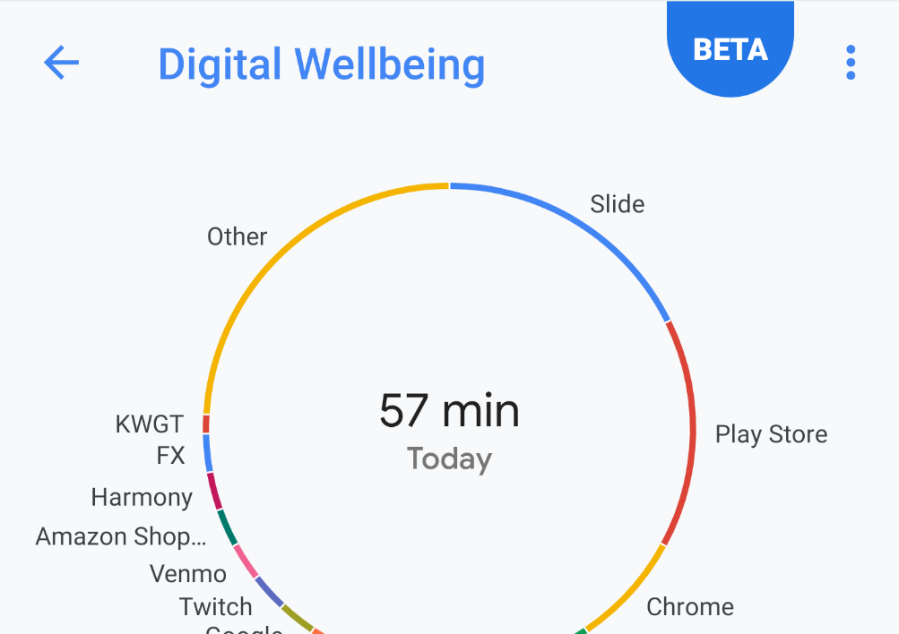
Definition
The concept that when humans interact with technology, the experience should support mental and/or physical health in a measurable way.
Promotes healthy use and proactively assists the user to maintain a healthy lifestyle.

Slide 4
Pros
Reducing eye strain in frequent device users.
Increasing emphasis on physical activity and nutrition.

Slide 5
Cons
Too convenient. (general issue).
Communicating to people through electronics more so than in person.
Spending too much time on electronic.
Rely too much on provided information.

Slide 6
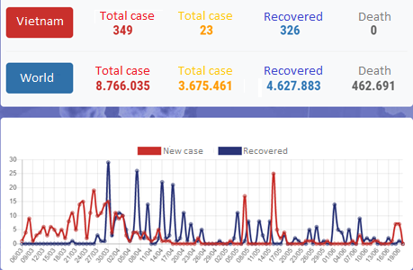
Green Zone Overview
COVID-19 is a major pandemic. It’s become more dangerous due to the increase of total cases and death case over the world.
The most dangerous thing of COVID-19 is very easy to infection.
No Vaccine.
Green Zone is an early warning application for COVID-19.

Slide 7
Green Zone Overview
Time : 6 months.
Scale: Hanoi, Vietnam.
Budget: $50.000.
Participants: 13.
Implement (GreenZone need to perform 3 tasks)
Collect data from credible sources.
Analyze collected data and make travel of infected people and mark epidemic areas with Google Map.
The information will be displayed on the user's Green Zone application after verified.

Slide 8
Green Zone Overview
Localize the disease area and infection travel.
Statistics about Corona over the world.
News and article about COVID.
Send Health Report.

Slide 9
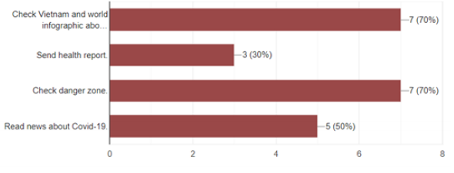
Finding Of Project
Green Zone project help people change behavior and take more care about health
Positive signal from people who do the survey and focus group about Green Zone project.
People have changed their behaviors and they really take more care about their and family health.
Almost people have sent their health report through Green Zone app.
Green Zone indirectly helped to make their lives healthier with some guide and article.

Slide 10
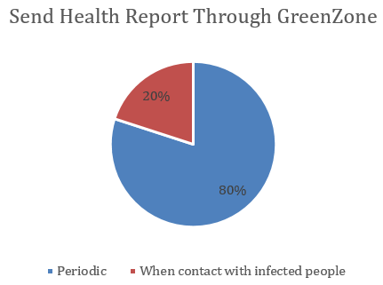
Finding Of Project
Green Zone project helps health ministry can easier to collect information.
Health Ministry get more information.
Easier to manage and make appropriate policies.
According to the collected data 80% of users will send their health reports through the app
The most accurate information of the Health Ministry will be displayed directly through the Green Zone.

Slide 11
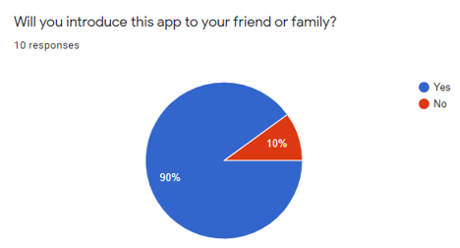
Finding Of Project
Green Zone project help prevent the spread of coronavirus.
The people's awareness is also a very important part.
The majority of users decided to use the application and recommend it to others.
Till the time of this report, Vietnam had no new cases in the community for 65 days.

Slide 12

Thank for listening!

